Slide 1
Comparison of Crime Rates In Ireland And India Using Machine Learning Methodologies
MSc Research Project
Chinmay Laxmikant Mukim
X21145024
MSc in Data Analytics

Slide 2
Introduction
Background
Research question : Which factors such as Population and Unemployment affect crime rates in Ireland and India? Using machine learning methodologies.
Assumptions

Slide 3
Related Work
Past work done on Indian crime rates
Previous work done on Irish crimes
Previous work done based on the models implemented on crime data
Previous work done on factors affecting crime rates

Slide 4
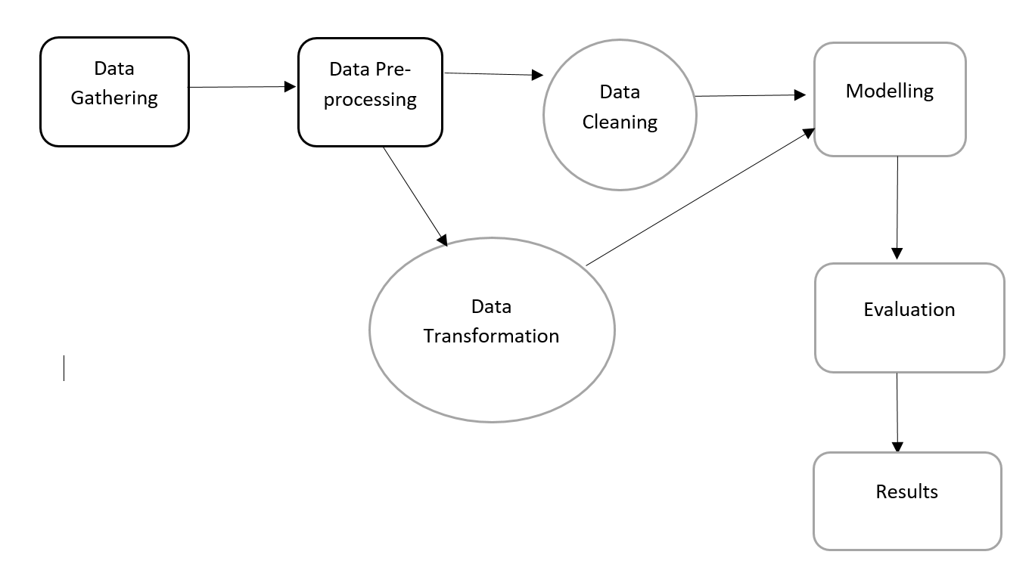
Methodology

Slide 5
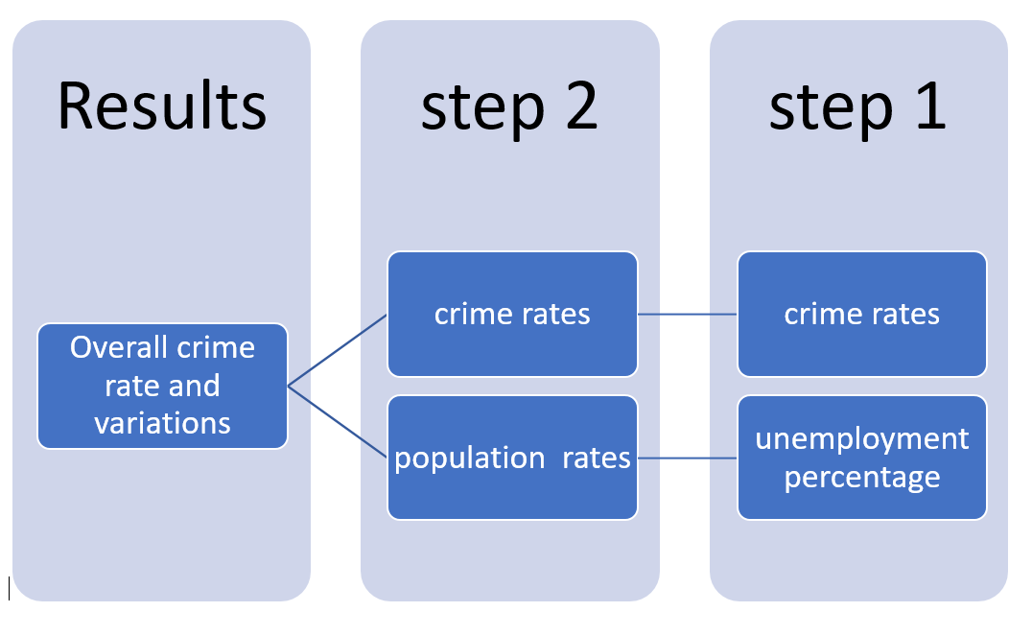
Design Specification

Slide 6
Architecture of implementation procedure
Description of Machine Learning Methodologies

Slide 7
Implementation
Implementation on Ireland’s Data
EDA on Ireland’s data
Implementation on India’s Data
List of the models which are implemented

Slide 8
Evaluation
Evaluation on Ireland’s data
Evaluation on India’s data
Performance of the models implemented
Comparison based on results
Discussion

Slide 9
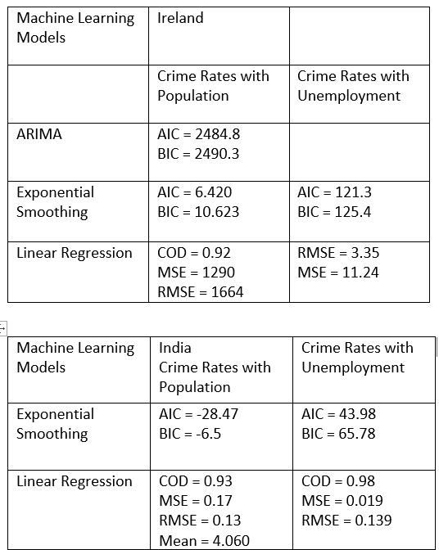

Slide 10
Conclusion
The Linear Regression is the best model for predicting crime with the Coefficient of determination of 0.92 for Ireland and 0.93 for India.
Dublin in Ireland and Andra Pradesh In India has most number of crimes
India has more crime compared to Ireland.
Unemployment is the which is responsible for increase and decrease in crime rates for both Ireland and India.

Slide 11
Future Work
Fetching Good Data.
Implementing additional models.
Good tuning for Neural Network.
Working on single type of crime deeply.

Slide 12
Thank You

